Slide 1
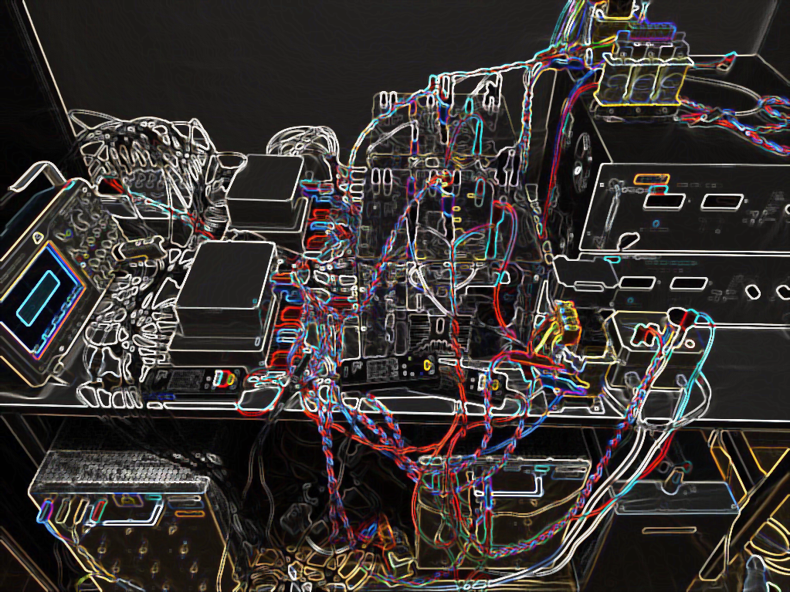
Neural network-based imitation of model predictive control for power converters
Aitor Teran, Cristina Roche, Pere Izquierdo

Slide 2
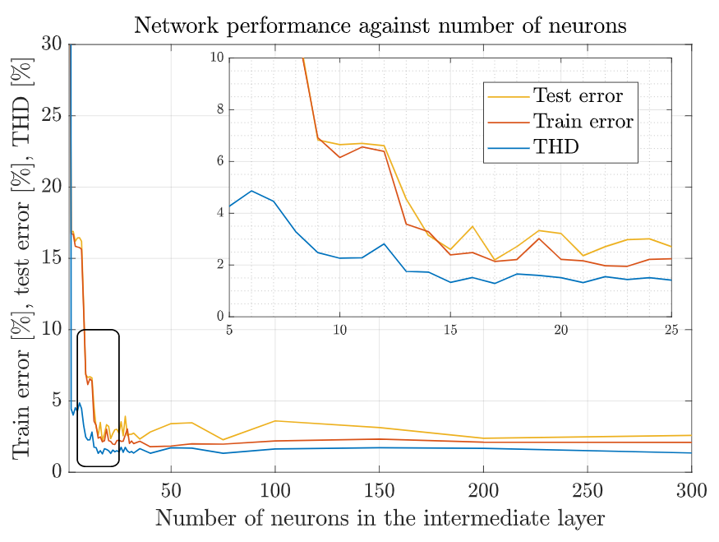
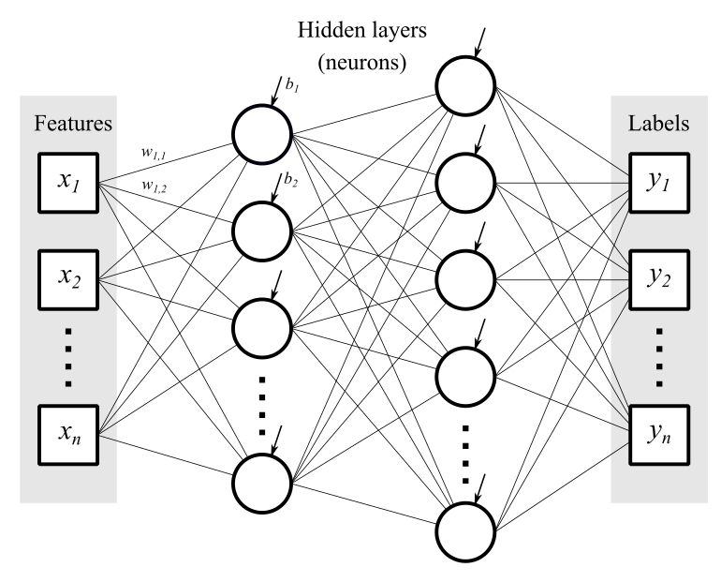
TRAINING THE NETWORK
Finding the optimal network configuration.
1 hidden layer with 15 neurons.
98% test accuracy
Notes:
Finding network configuration: activation functions, cost function, optimization algorithm. Non-convexity of training a neural network.
Adding several layers does not significantly improve the performance of the network.
For a single layer, error and THD values are compared to obtain the optimal number of neurons.

Slide 3
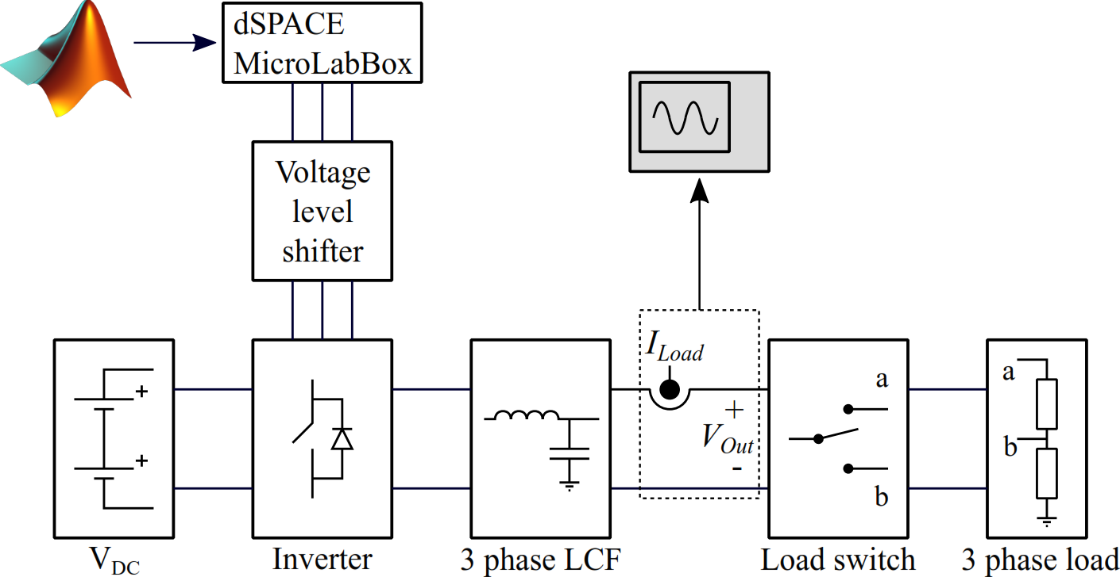
LABORATORY SETUP
Notes:
Explain the control scheme. Inputs: reference voltage, output voltage, inductor current, load current, previous system state.
Network trained using TensorFlow in Python using 2 million grid-generated data points within the operating range of the lab setup.
Validation and testing of the neural network performed on 1 million random data points inside the same bounds.

Slide 4
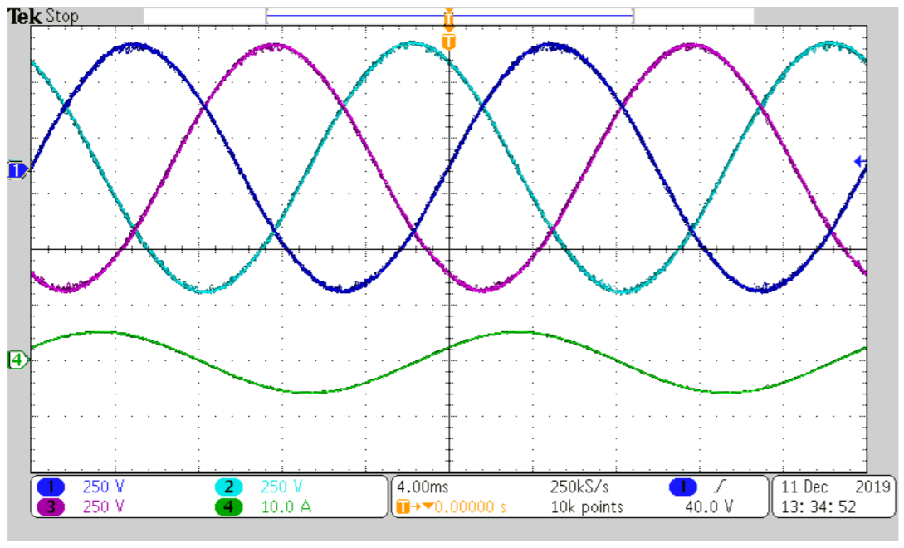
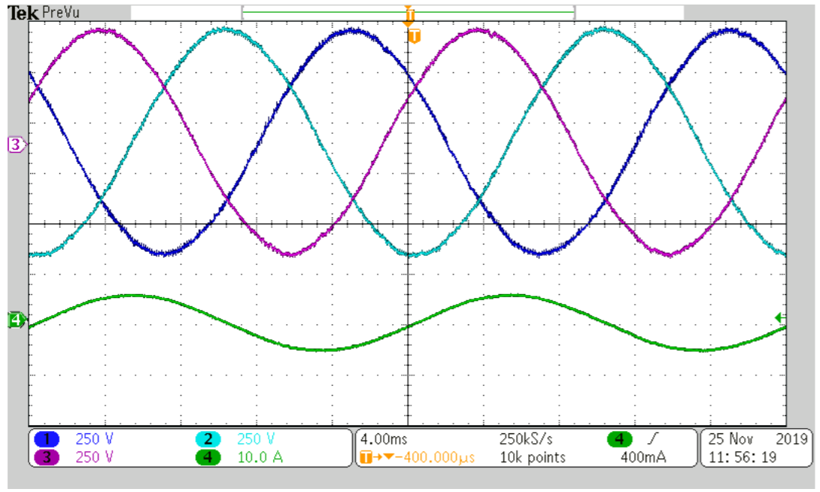
RESULTS
MPC
Why is the same figure shown twice?
ANN
Notes:
This slide shows how good the ANNs are at approximating MPC.
Very similar THD and switching frequencies.
1-step MPC takes 10 us, 2-step takes 13 us. ANNs always take 11 us.

Slide 5
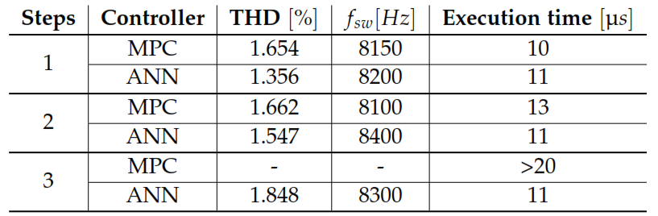
STEADY STATE

Slide 6
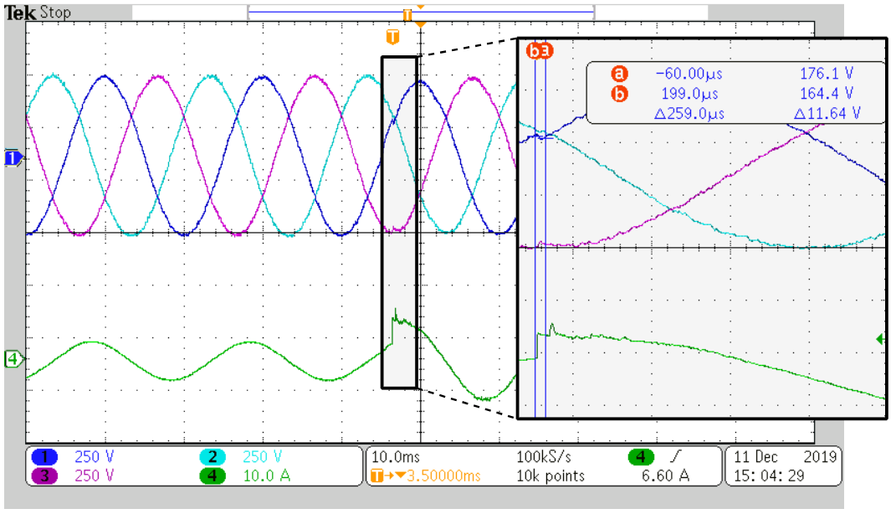
RESULTS
Imitator transient response
Notes:
Fast and accurate load transient response.
Current spike because of switching device.

Slide 7
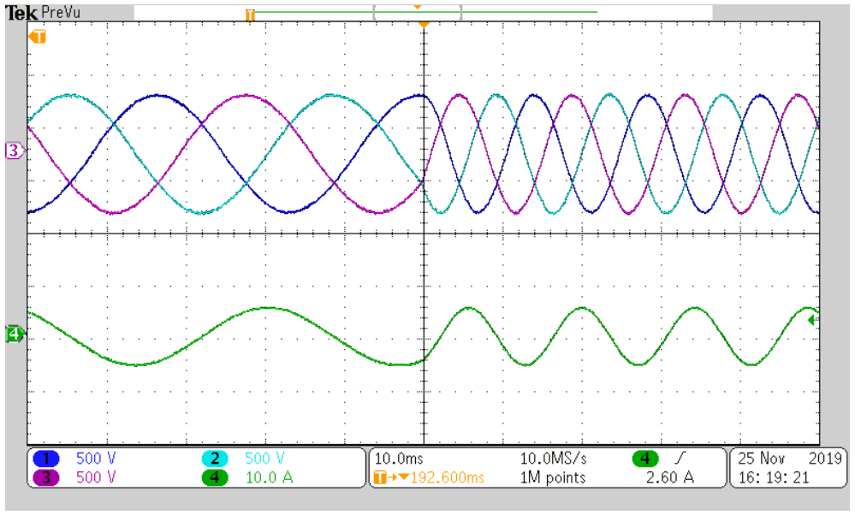
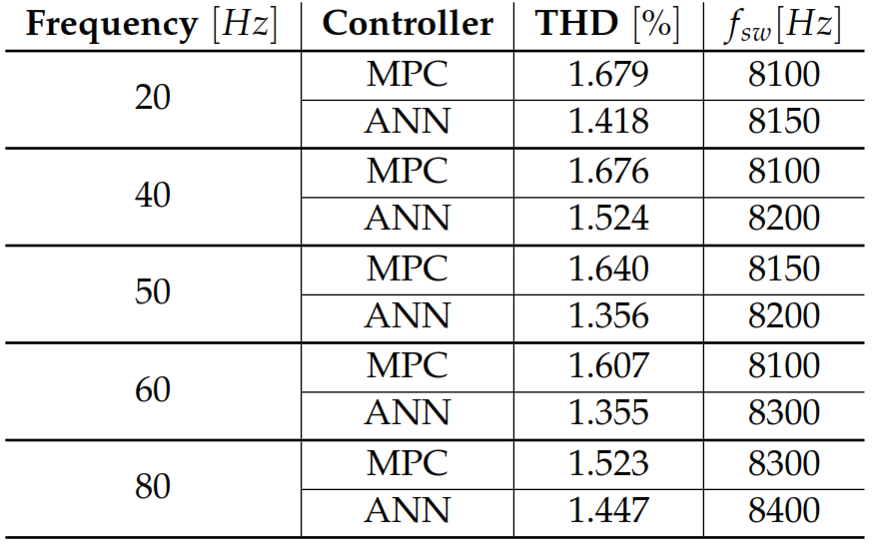
RESULTS
Imitator robustness
Notes:
Ability to extrapolate to untrained data.
Surprisingly, the imitators are robust to changes in reference voltage amplitude and frequency, even though they were not trained for it.

Slide 8
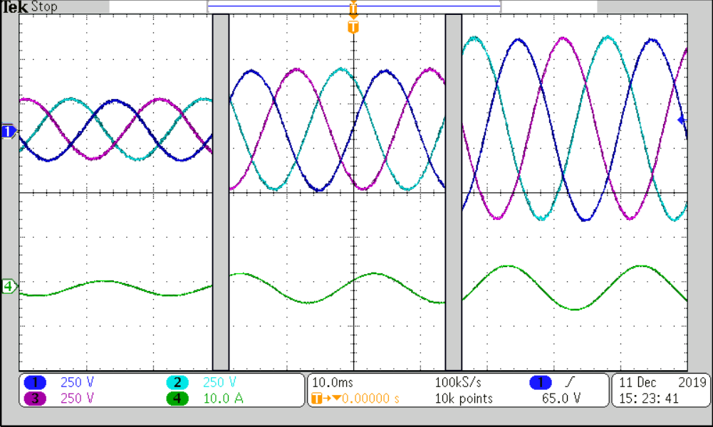
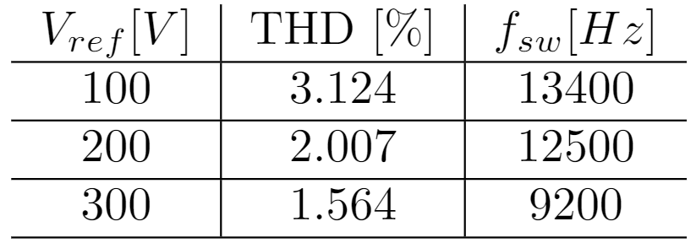
RESULTS
Imitator robustness

Slide 9
CONCLUSION
The imitation method removes the computational limitations of FS-MPC, while maintaining its performance.
ANNs show great potential for application in the field of power electronics.
In principle, the method could be used for any control scheme.
Notes:
Surprisingly, the imitators are robust to changes in reference voltage amplitude and frequency, even though they were not trained for it.

Slide 10
FUTURE WORK
Change the load to resemble a grid.
Improve training for 2 and 3 steps ahead.
Train for more steps ahead.
Implement ANN control in more complex converters.

Slide 11
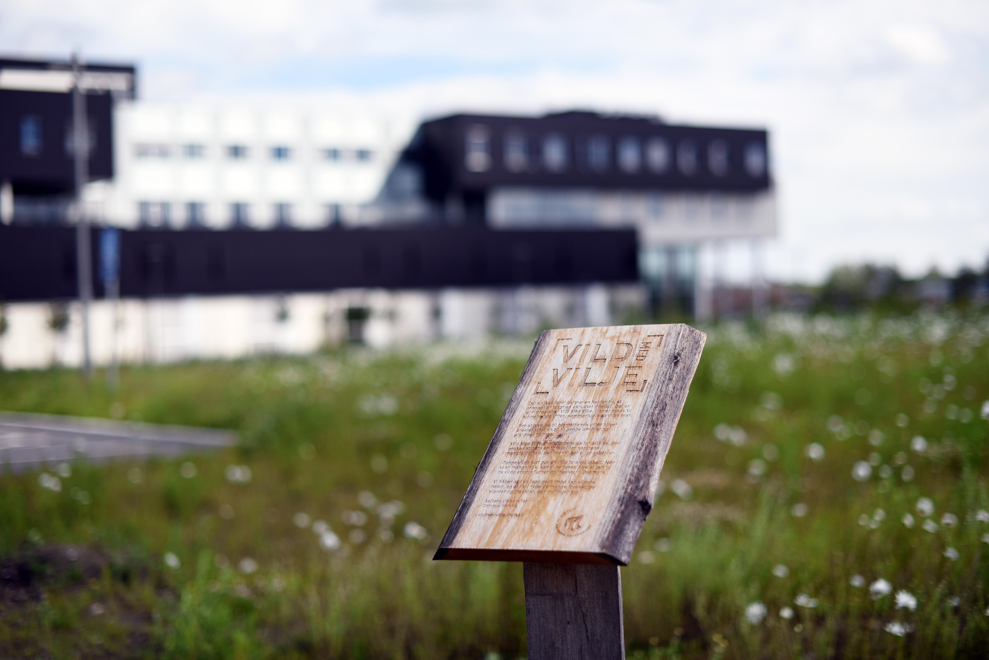
THANK YOU
THANK YOU

